Slide 1

Flux flow
By:
Cheran
Sweeja
Yeshwanth
Sadia Mahbub

Slide 2
Why Flux flow
Generally, we will use certain algorithms to detect the anomalies, we can easily raise a question that based on what criteria the algorithm is identifying the anomalies and how the detected anomalies are different from others.
In order to face the above challenges, we will be using the flux flow to detect anomalies on social media. Flux flow is combination of Machine Learning algorithms/methods to detect the anomalies.
We will give the social media data as input to the FLUX FLOW and it will process the information and will provide output anomalies like outliers, redundant data and noisy data.

Slide 3
About Flux flow
It is an interactive visual analysis tool like Tableau for analyzing anomalous information on social media.
It contains several machine learning algorithms to analyze the anomalous information and to present it in visual format.
It will provide quality/understandable visualizations of the anomalous data which is found the ML algorithms. We can use those visualizations for further analysis/research studies.
Anomalous information can be considered as the noisy data or redundant values; Simply, The events which are impossible to occur for example, Sky is falling on the ground, these kind of anomalous information can be considered as rumors and wrong information. The flux flow is used to detect these kind of anomalies in the social media.

Slide 4
What are anomalies
Anomalies are sometimes referred to as outliers, novelties, noise, deviations or exceptions, They can be detected and removed by the ML algorithms Like supervised semi-supervised and unsupervised learning algorithms.
First, the data is collected from the social media sites like Twitter and then they are loaded to Hadoop eco-system, from there using the map-reduce functions we will load it to database/stores.(the stored data is pre-processed; The data will be cleaned, transformed, reduced and extracted).
In the Analysis part, The anomalies will be detected based on several techniques like scaling, KPI and density based etc. For each repeating anomalies, certain number or rank will be assigned by the algorithm to detect them.
At the end the detected anomalies will be presented in the visual format for easy understanding of anomalies.

Slide 5
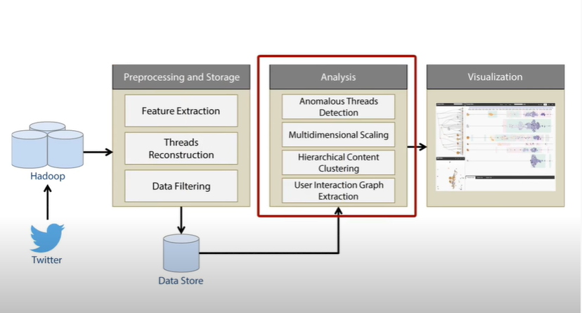
Working model of Flux Flow

Slide 6

Model infrastructure
The flux flow is divided into two sub-models.
They are front-end and back-end models, The front-end model is used for generating interacting visualizations which are useful for the analysts to find insights in the data and understand the underlying analytical methodology. Unusual retweeting threads/anomalies can be found using the back-end model.

Slide 7
Working of Ml models
Analytic models such as OCCRF and Latent Dirichlet Allocation are generally used ML models
To find unusual dialogue threads on Twitter, we use the one-class conditional random fields (OCCRF) model. We employ OCCRF because the data is "one-class" in nature, that is, there is limited understanding of actual anomalies, and there are significant time-dependent patterns (the user retweeting behaviors).
The easy techniques to anomaly identification is to identify outlier peaks or other anomalous spots in timeseries of subjects or occurrences or other sequences. The abnormal sequences (retweeting threads) in the mass information propagation on social media are identified.
The anomalies are not easy to represent visually, We apply well-known visual analytics methods to streaming text data, with a particular focus on social media, in three domains: events, themes, and information dissemination.

Slide 8
Detail Explanation of flux flow
The FluxFlow system, which consists of three main parts—a data preprocessing and storage module, a data analysis module, and a visualization module—is intended for identifying, investigating, and comprehending unusual conversational threads on Twitter.
The data storage and preprocessing module uses Apache Hadoop on a cluster and consists of three parts: thread feature extraction, reconstruction of retweeting threads from raw tweets, and data filtering based on user interests (for example, keywords).
To facilitate effective parallel processing of huge data, all of these components are developed using the Map-Reduce framework. The results are kept in a database that can accommodate online inquiries.

Slide 9
FluxFlow calculates an anomaly score for each retweeting thread and ranks them in a non-increasing manner in the analysis module. To better comprehend the anomaly
Based on a number of algorithms, including multidimensional scaling (MDS) and hierarchical topic clustering, we computed contextual information to show:
1) how threads are distributed in the anomaly feature space.
2) how messages under similar topics spread in different ways.
3) how Twitter users in these threads interact with one another.

Slide 10
Detecting and interpreting anomalous retweeting threads
Challenges of detecting anomalous retweeting threads:
Temporal dependency - capturing how information spreads over time
No clear definition of a true anomaly - so have to assume most retweeting threads are normal
OCCRF
A recent technique for detection without the need of having true anomalous examples
Outperforms traditional anomaly detection algorithms
Computes and anomaly score of a sequence by measuring how the information spreading pattern is different from an unlabeled example set Applied to based on a set of features extracted from Twitter data

Slide 11
Interaction Graph Features
User Profile Features
Follower count, friends, status, etc
Indicates how active a user is
Features useful for identifying bots have been computed in addition to profile features
User Network Features
Inter-user interaction measured - helps detect collusion
All incoming and outgoing links to user from other users from the thread measured
Temporal Features
Features specific to the current tweet- retweet count, device popularity
Log of interval between two adjacent Tweets in in the sequence- helps distinguish sequence speed
Content Features
Count of psychological keywords - indicates authors’ and responders’ emotions
Hypothesizes that anomalous events trigger anomalous responses
Content features are thought to have little variation across the threads

Slide 12
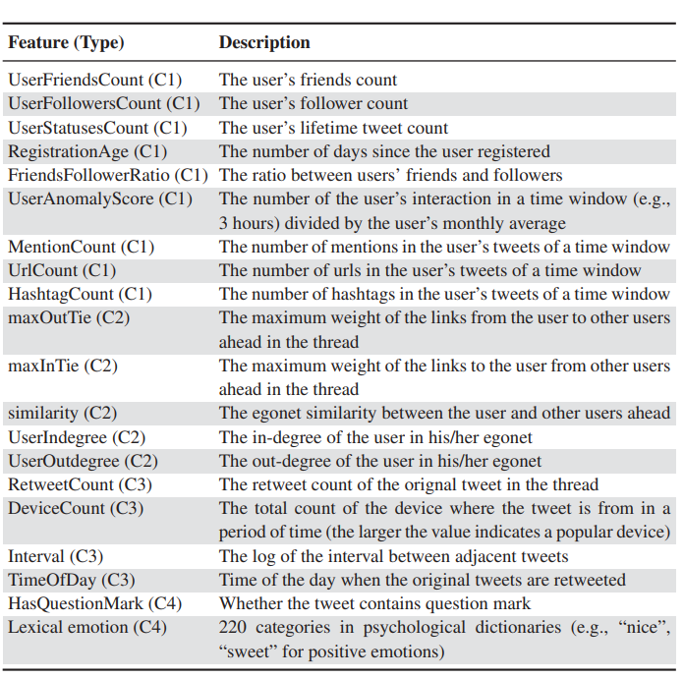
Extracted Features Summary
239 total features
220 look for psychological keywords defined in dictionaries

Slide 13
Interpreting anomalies in context
FluxFlow Helps understand anomaly scores from the OCCRF Model
Feature differences between an anomalous thread and another thread provides intuitive interpretation
A thread that disseminates a message differently than other patterns can be considered anomalous
Interactions between users can imply why a thread is anomalous

Slide 14
The 5 visualizations
Retweeting threads with OCCRF rankings and anomaly scores
Hidden states and vectors used in OCCRF
MDS projection in feature space
Hierarchical topic clusters of threads
Historical interactions among users

Slide 15
Design guidelines for developing visual analytics systems for information spreading
Summarizing and aggregating important features of retweeting threads
Indicating characteristics and connections of involving users
Reveals temporal patterns of information spreading
Facilitating visual data comparisons and correlations
Providing diverse data perspectives and views
Accessing deep-level information of the model and input

Slide 16
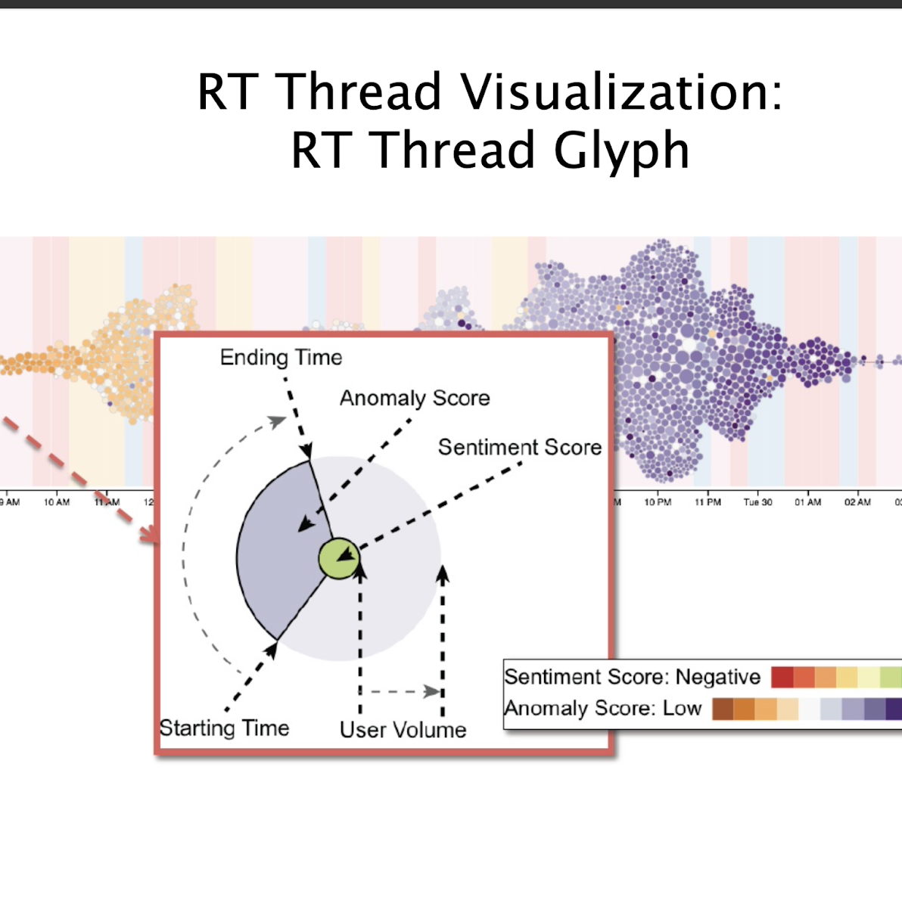
SPREADING ON SOCIAL MEDIA:
Thread glyphs to consolidate key Information and three thread timeline Visualizations to uncover temporal Patterns with different perspectives.

Slide 17
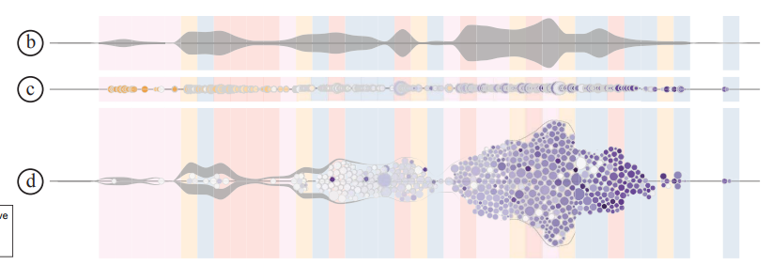
Thread Timelines
b = Volume chart - shows temporal user trends such as: male, female, etc
c = Linear circle view - illustrates timestamp of each retweet event, each user a small circle
d = Volume circle view - important thread participants displayed

Slide 18
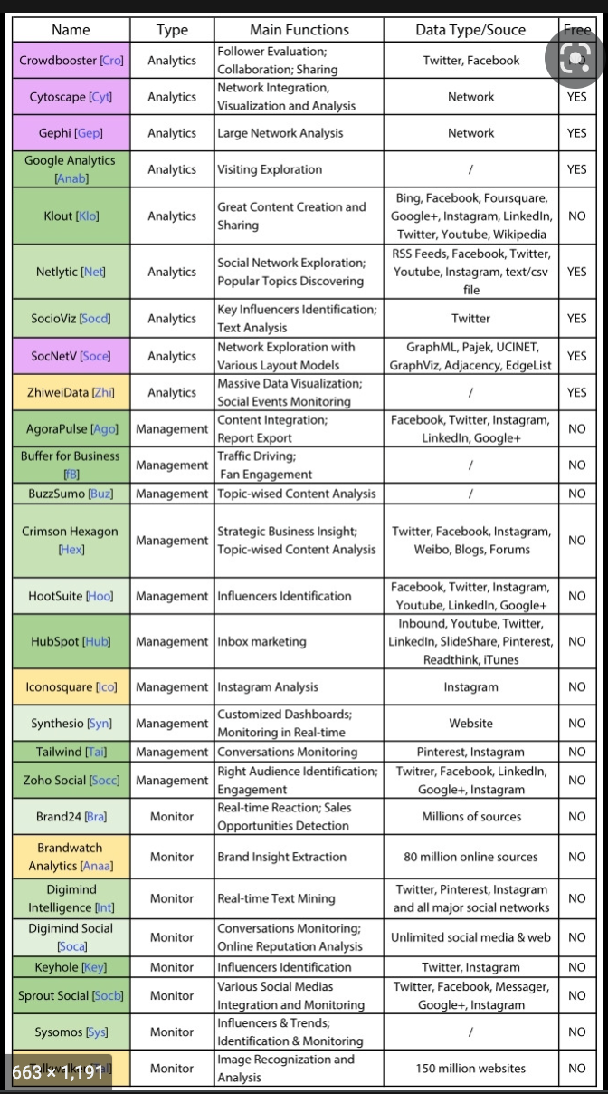
Social Media Visual Analytics:
With the development of social media (such as Twitter, Flickr, Foursquare, Sina Weibo, etc.), a large number of people are now using them and the information provides meaningful information and reflects human social behavior.

Slide 19
Task Summary
Summarizing and aggregating important features of retweeting threads.
– Glyph, Cluster View, MDS View
• Indicating characteristics and connections of involvingusers. – User relationship graphs
Revealing temporal patterns of information spreading. – Thread Timeline
Facilitating visual data comparisons and correlations. – Cluster View, MDS View
Accessing deep-level information of the model and input. – Thread Timeline, Features View, Status View, Tweets View

Slide 20
Visualization techniques summary
Multiform, Overview/Detail. Linked Highlighting.
Item filtering, Item aggregation, Attribute aggregation, Elide, Superimpose.
Highlighting, Project, Zoom.
Glyph, Thread Timelines.

Slide 21
Evaluation
Datasets: two 10% Twitter feed datasets collected during two significant events: – 2012 Hurricane Sandy(52 million tweets) – 2013 Boston Marathon Bombing(242 million tweets)
Baseline: One-Class SVM (OCSVM) [Scholkopf et al., 2001]
Ground truth: manually labeled by three annotators to based on reports after the events

Slide 22
DISCUSSION
There exist some limitations of the current prototype that we would like to address.
First, the anomaly detection process of OCCRF could be long and tedious, due to large data scales.
Second, since user interaction data is only partially available in Twitter, we estimated the social connection graph based on users’ mentioning and retweeting behaviors from historical datasets, which assumes that the graph structure did not change.
Third, despite that FluxFlow incorporates a number of visualizations to allow an in-depth comprehension of the anomaly detection model.

Slide 23
Directions for generalizing and extending our current system
First, while FluxFlow is built with OCCRF, its visualization component can stand alone to serve a more general tool for visual exploration of information propagation on social media.
The multi-scale representation and interaction in the cluster view is flexible enough to be applied in navigating any hierarchical data.
If the analytics computation can be improved for real-time processing, the thread timeline views can be extended to represent dynamic retweeting data.
Lastly, to further facilitate the exploration of retweeting threads, we can easily incorporate FluxFlow with interactive filtering techniques

Slide 24
CONCLUSION
FluxFlow systemically incorporates a set of algorithms
to characterize retweeting threads,
perform anomaly detection in those threads, and
produce an effective visual interface.
FluxFlow’s anomaly detection algorithm is efficient in identifying misinformation, and the visualization is useful for analysts to discover insights and comprehend the model.

